Slide 1


Fedora Infrastructure Overview
Michal Konečný
Infra & Releng Team Lead
zlopez@fedoraproject.org
@zlopez:matrix.org
Extra icons:

Slide 2





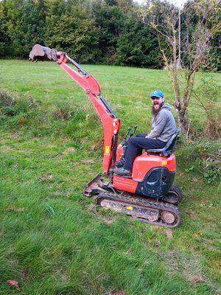






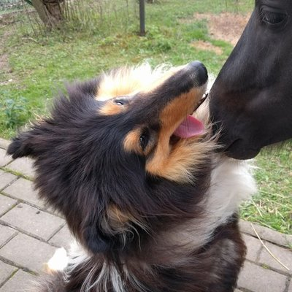
Who?
kevin
abompard
adamwill
darknao
dkirwan
humaton
mizdebsk
nb
nphilipp
pbrobinson
praiskup
ryanlerch
zlopez
Notes:
Members of sysadmin-main
Plenty of other people in Fedora that are helping

Slide 3
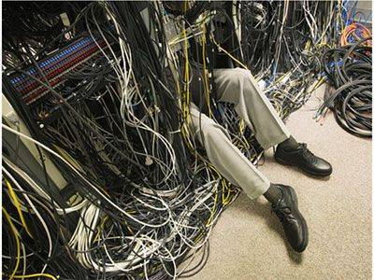
What?
Image source: TechRepublic
Notes:
What Fedora Infrastructure does in Fedora.
* Handling server hardware issues
* Maintaining code of infrastructure applications
* Keeping servers up and updated

Slide 4
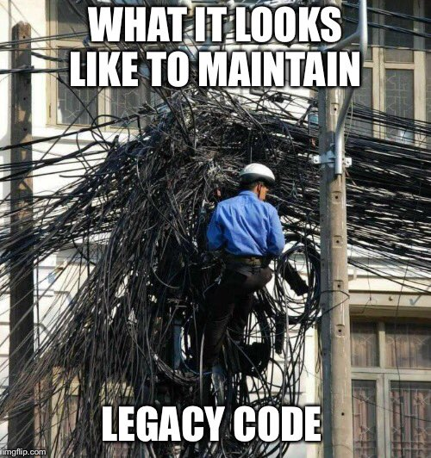
What?
Image source: TechRepublic
Notes:
What Fedora Infrastructure does in Fedora.
* Handling server hardware issues
* Maintaining code of infrastructure applications
* Keeping servers up and updated

Slide 5
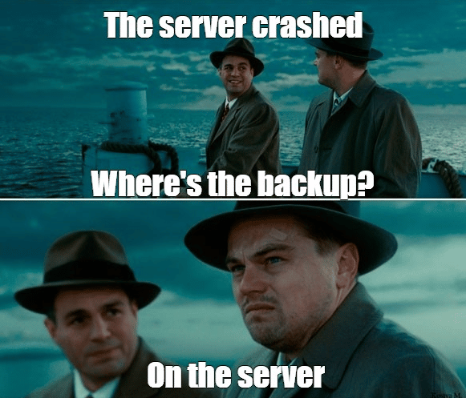
What?
Image source: TechRepublic
Notes:
What Fedora Infrastructure does in Fedora.
* Handling server hardware issues
* Maintaining code of infrastructure applications
* Keeping servers up and updated

Slide 6
What?
Notes:
What Fedora Infrastructure does in Fedora.
* Helping with deployment of new apps
* GDPR requests
* Dealing with spam in mailing lists or issue trackers

Slide 7
WHERE?
Notes:
Where can you find us

Slide 8
PAST
Notes:
What we did

Slide 9
PRESENT
Notes:
What we are working on right now

Slide 10
FUTURE
Notes:
What is planned

Slide 11

By metrovinz at deviantart
Notes:
How can you help

Slide 12
Thank You!
Questions?

Slide 13

Subtitle
Some body text as an
example of how that
would look.
Image caption text, attribution, etc. go here.

